Slide 1

Testing the Endpoints
of Your REST APIs
Notes:
I’m a music lover and I love live music and go to a lot of concerts. Over the years, it’s hard to remember all the details, and I find myself reminiscing with a friend, and we’re like, what year did we see Radiohead in Chicago? What venue was that? So I had the idea of writing an application that would allow me to record all the concerts I go to – it would be my Concert Diary.
Today we are going to talk about the process of testing the API for that application. More specifically, we’re talking about Unit testing in Visual Studio and Integration testing with Postman. This is a beginner level talk for people who aren’t already comfortable with unit testing and integration testing in Postman.

Slide 2
Tonya Cooper
@tonyazen

Slide 3





































TITANIUM SPONSORS
Platinum Sponsors
Gold Sponsors
Notes:
Big thanks to all of the KCDC Sponsors. They make this event possible and affordable.

Slide 4
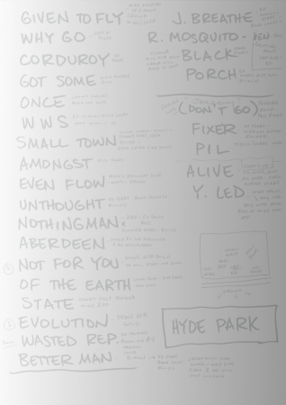
Our Setlist
Importance of Testing
Layers of Testing
Unit Tests: Solving Two Problems
external dependencies
what to test
Integration Testing with Postman
Wrap Up
Notes:
We will briefly discuss the importance of testing and the layers of testing. Then we will move on to our the first main topic, which is unit testing and solving two common problems. The second section is on Integration Testing with Postman. We’ll save some time at the end for questions.

Slide 5


Importance of Testing
Notes:
I worked on a team at a different company where we did very, very little Unit testing. We focused our testing efforts on end-to-end testing – which is also important. But we only had a few unit tests, most of which were disabled over time, and a few integration tests that tested the integration of some third party APIs, but none for our own APIs. (Talk about lack of confidence when making changes, etc.)
Making time for writing tests is like making time for working out: It takes two months of pain and agony to get into shape and only two weeks of not doing it to get out of shape. So really, you don’t have time to NOT work out. You don’t have time to NOT test.

Slide 6
The Layers of Testing
UI
Tests
Expensive to run and maintain
Service Tests
More complex to run and maintain
Unit Tests
Cheap and fast to run
Notes:
The Test Pyramid was the concept of Mike Cohn in his book Succeeding with Agile. There are many ways to look at the layers of testing, but this is a good place to start.

Slide 7
Unit Tests
No external dependencies
Each method runs in isolation
Cheap and fast to execute
Execute on each commit
UI
Tests
Service Tests
Unit Tests
Notes:
Unit tests are at the base because, in this model, they should compose the majority of your tests. Unit tests do not test external dependencies, such as file systems, databases, or message queues. Because they don’t call these external dependencies, they are fast to execute.
Unit tests are not order dependent. That means it doesn’t matter in what order they are run. So, your unit test should not require another unit test to run first, or depend on the result of another unit test.
Talk about what is meant by unit? The test is the unit, not the code being tested. If you tightly couple your unit tests to your code design, it will need to constantly be refactored and updated as your code evolves. https://content.pivotal.io/blog/what-is-a-unit-test-the-answer-might-surprise-you
Nunit, MSTest, xUnit

Slide 8
Service Tests
External dependencies
Longer to run
Execute on each push
Includes
Integration Tests
Contract Tests
Component Tests
UI
Tests
Service Tests
Unit Tests
Notes:
Although our Unit tests are fast and plentiful, if we only test our code in isolation, we will miss issues that may occur with module interconnectivity. Service tests can test the interaction with another separate service or several services/dependencies, depending on your approach. In the micro service world where you are interacting with more than one service, you will have service tests that do both. Integration testing is sometimes applied to a broader set of tests that can be broken down into 3 areas: A more focused sense of integration testing where we check basic success and error paths and checking that, when a request is not successful, we receive an appropriate error. Integration tests also test an API Gateway if one is used and checks for HTTP headers and SSL handling. Contract testing verifies communication between a provider and a consumer, like an API and a web front-end, or be an API and a message queue. It isn’t behavior or functionality that is being tested here, it is just testing that the inputs and outputs have the agreed upon attributes. Do the requests and responses mirror what the service contract promises?

Slide 9
UI Tests
End-to-end tests
UI functionality
UI
Tests
Service Tests
Unit Tests
Notes:
For UI tests, a team might use a tool like selenium to automate common interface paths a user will take that touch the services. Because this talk does not focus on this layer, this is

Slide 10
Pyramid Frustum
Service Tests
Unit Tests
Notes:
Today, we are just looking at the bottom two layers, making it a frustum. That’s just bonus trivia – it has nothing to do with testing ☺.

Slide 11


Unit Tests: Solving 2 problems
My controller has dependencies
I don’t know what to test
Notes:
So as I was saying, I wrote this application to record my concerts, and as I was writing unit tests for it, there were two struggles and I want to show you how I solved those issues.

Slide 12


Problem 1:
My controller has dependencies
Notes:
Most of the time your endpoints will have some dependencies – they will be interacting with a database, or a message queue, or other services. My application has a service for getting data in and out of a database, and a service for sending tweets.

Slide 13
[TestMethod]
[TestCategory("Unit")]
public void CreateConcert_Returns_Successful()
{
var response = _controller.CreateConcert(false, _concert);
Assert.IsTrue(response.Concert.Id > 0);
Assert.IsTrue(response.RequestId.Length > 0);
}
[TestMethod]
[TestCategory("Unit")]
public void SendTweet_ReturnsTweetUrl_Successful()
{
var response = _controller.CreateConcert(true, _concert);
Assert.IsTrue(response.TweetUrl.Length > 0);
}
...
Notes:
In my first attempt to write unit tests, I was very generically validating values on my response object. I couldn’t be more specific because I didn’t control the data my dependencies produced.

Slide 14
[Route("api/concerts"), HttpPost]
public CreateUpdateConcertResponse CreateConcert([FromUri] bool tweetConcert, [FromBody] Concert concert)
{
var requestId = Guid.NewGuid().ToString("N");
RequestValidator.ValidateWebRequestHeaders(Request);
if (concert == null)
throw new ClientRequestException(HttpStatusCode.BadRequest, "Failed to parse Concert.");
if (!concert.ValidateConcert())
throw new ClientRequestException(HttpStatusCode.BadRequest, "One or more Concert prop...");
var concertService = new ConcertService();
var tweetService = new TweetService();
var responseModel = concertService.CreateConcert(requestId, concert);
responseModel.TweetUrl = tweetConcert
? tweetService.TweetConcert(concert)
: string.Empty;
return responseModel;
}
Dependencies
Notes:
My endpoint is creating new instances of my services.

Slide 15
[Route("api/concerts"), HttpPost]
public CreateUpdateConcertResponse CreateConcert([FromUri] bool tweetConcert, [FromBody] Concert concert)
{
var requestId = Guid.NewGuid().ToString("N");
RequestValidator.ValidateWebRequestHeaders(Request);
if (concert == null)
throw new ClientRequestException(HttpStatusCode.BadRequest, "Failed to parse Concert.");
if (!concert.ValidateConcert())
throw new ClientRequestException(HttpStatusCode.BadRequest, "One or more Concert prop...");
var concertService = new ConcertService();
var tweetService = new TweetService();
var responseModel = concertService.CreateConcert(requestId, concert);
responseModel.TweetUrl = tweetConcert
? tweetService.TweetConcert(concert)
: string.Empty;
return responseModel;
}
Notes:
And then calling methods on those services. So what’s wrong with that?
We don’t want to manipulate data in the repository every time we run our unit tests.
The services may not be up, and may still be in development when we run our unit tests.
And unit tests should not be testing external dependencies. That job will be saved for our integration tests. We need a way to get around that.

Slide 16
Dependency Injection
Notes:
We can use dependency injection to solve this problem. Dependency injection is a design pattern where a dependency is passed into an object rather than have that object create its own dependencies. This pattern helps us to avoid tight coupling. The reason why we care about it from a unit testing standpoint is because we can pass in mocked implementations of our dependencies. There are several dependency injection frameworks for .NET out there. Unity and Ninject are two that I’ve worked with. If you are using ASP.NET Core, it has Dependency Injection built in.

Slide 17
private readonly IConcertService _concertService;
private readonly ITweetService _tweetService;
public ConcertsController(IConcertService concertService, ITweetService tweetService)
{
_concertService = concertService;
_tweetService = tweetService;
}
[Route("api/concerts"), HttpPost]
public CreateUpdateConcertResponse CreateConcert([FromUri] bool tweetConcert, [FromBody] Concert concert)
{
var requestId = Guid.NewGuid().ToString("N");
RequestValidator.ValidateWebRequestHeaders(Request);
if (concert == null)
throw new ClientRequestException(HttpStatusCode.BadRequest, "Failed to parse Concert.");
if (!concert.ValidateConcert())
throw new ClientRequestException(HttpStatusCode.BadRequest, "One or more Concert prop...");
...
Notes:
This is how we setup our controller to use DI.
1. First, we add a constructor that takes our two dependencies as parameters.
2. Instead of passing in concrete classes, our service classes now implement interfaces. Using interfaces will allow us to pass in “mocked” implementations of our dependencies, which we’ll cover next.
3. In this case, I’m using Unity for my Dependency Injection, so I registered these two dependencies with a Unity container which just involved a little configuration.
4. The Unity container will inject the concert service and tweet service objects when the Concerts Controller object is created.

Slide 18
[Route("api/concerts"), HttpPost]
public CreateUpdateConcertResponse CreateConcert([FromUri] bool tweetConcert, [FromBody] Concert concert)
{
var requestId = Guid.NewGuid().ToString("N");
RequestValidator.ValidateWebRequestHeaders(Request);
if (concert == null)
throw new ClientRequestException(HttpStatusCode.BadRequest, "Failed to parse Concert.");
if (!concert.ValidateConcert())
throw new ClientRequestException(HttpStatusCode.BadRequest, "One or more Concert prop...");
var concertService = new ConcertService();
var tweetService = new TweetService();
var responseModel = concertService.CreateConcert(requestId, concert);
responseModel.TweetUrl = tweetConcert
? tweetService.TweetConcert(concert)
: string.Empty;
return responseModel;
}
Notes:
Now that we are passing the dependencies in our constructor, we no longer need to do this.

Slide 19
[Route("api/concerts"), HttpPost]
public CreateUpdateConcertResponse CreateConcert([FromUri] bool tweetConcert, [FromBody] Concert concert)
{
var requestId = Guid.NewGuid().ToString("N");
RequestValidator.ValidateWebRequestHeaders(Request);
if (concert == null)
throw new ClientRequestException(HttpStatusCode.BadRequest, "Failed to parse Concert.");
if (!concert.ValidateConcert())
throw new ClientRequestException(HttpStatusCode.BadRequest, "One or more Concert prop...");
var responseModel = _concertService.CreateConcert(requestId, concert);
responseModel.TweetUrl = tweetConcert
? _tweetService.TweetConcert(concert)
: string.Empty;
return responseModel;
}
Notes:
And here we are calling the services with the private read-only fields that we set inside our constructor.

Slide 20
Mocking

Slide 21
[TestClass]
[ExcludeFromCodeCoverage]
public class CreateConcert
{
private ConcertsController _controller;
private Mock<IConcertService> _concertService;
private Mock<ITweetService> _tweetService;
private HttpRequestMessage _request;
private Concert _concert;
private readonly string _requestId = "8325e2f14e07411cadf9608dfaa98915";
private readonly string _tweetUrl = "https://twitter.com/musiclover/status/987654321";
[TestInitialize]
public void Intialize()
{
...
}
Notes:
As I mentioned earlier, we want to pass in mocked implementations of our services. We use mocks when we don’t want to invoke the code of these classes. In this case we don’t, because we aren’t testing the concert repository or the external tweet service. We will leave those tests to our integration testing.
I’m using the .NET Framework library Moq M-O-Q. This creates an object that implements our service interfaces. It will prevent the code in our real services from being invoked. It will also allow us to set up the objects to return test data that mimics real data. You can install this mocking library from nugget.

Slide 22
[TestInitialize]
public void Intialize()
{
_concertService = new Mock<IConcertService>();
_tweetService = new Mock<ITweetService>();
_controller = new ConcertsController(_concertService.Object, _tweetService.Object);
_request = new HttpRequestMessage();
_request.Headers.Add("app_id", "testapp");
_request.Headers.Add("user", "testuser");
_controller.Request = _request;
_concertService.Setup(s => s.CreateConcert(It.IsAny<string>(), It.IsAny<Concert>()))
.Returns(() => new CreateUpdateConcertResponse
{
RequestId = _requestId,
Concert = ConcertTestData.GetCreatedConcert(),
});
_tweetService.Setup(s => s.TweetConcert(It.IsAny<Concert>()))
.Returns(() => _tweetUrl);
_concert = ConcertTestData.GetConcertToCreate();
}
Notes:
In our Initialize method, we can setup our mock objects to return test data. Here we are saying Setup our concert service so that when Create Concert method on our service is called, and any string is passed in, and an object of type Concert is passed in, return a response object with Request ID that we set up, and a concert object with test values.

Slide 23
[TestInitialize]
public void Intialize()
{
_concertService = new Mock<IConcertService>();
_tweetService = new Mock<ITweetService>();
_controller = new ConcertsController(_concertService.Object, _tweetService.Object);
_request = new HttpRequestMessage();
_request.Headers.Add("app_id", "testapp");
_request.Headers.Add("user", "testuser");
_controller.Request = _request;
_concertService.Setup(s => s.CreateConcert(It.IsAny<string>(), It.IsAny<Concert>()))
.Returns(() => new CreateUpdateConcertResponse
{
RequestId = _requestId,
Concert = ConcertTestData.GetCreatedConcert(),
});
_tweetService.Setup(s => s.TweetConcert(It.IsAny<Concert>()))
.Returns(() => _tweetUrl);
_concert = ConcertTestData.GetConcertToCreate();
}
Notes:
In our Initialize method, we can setup our mock objects to return test data. Here we are saying Setup our concert service so that when Create Concert method on our service is called, and any string is passed in for the request ID, and an object of type Concert is passed in, return a response object with Request ID of our constant request ID (check to make sure I show this), and a concert object with test values.

Slide 24
[TestMethod]
[TestCategory("Unit")]
public void PostConcert_Returns_Successful()
{
var response = _controller.CreateConcert(false, _concert);
Assert.AreEqual(1237, response.Concert.Id);
Assert.AreEqual(_requestId, response.RequestId);
}
[TestMethod]
[TestCategory("Unit")]
public void PostConcert_SendTweet_Successful()
{
var response = _controller.CreateConcert(true, _concert);
Assert.AreEqual(_tweetUrl, response.TweetUrl);
}
...
Notes:
Now that we’ve set up our mocks, our tests can be more specific. We can verify that properties on our response objects are returned with a specific value. That value is from the test data we setup.

Slide 25

Problem 1:
My controller has dependencies
Notes:
So now we’re jamming with testable code. We have solved problem 1 with dependency injection. Our services implement interfaces and we pass our services into the constructor of our controller. Our test class passes in mocked implementations of our services so that the dependencies don’t get called. This allows us to Setup the dependency methods to return values that we control and can test. We don’t touch our repositories, and everyone is happy!

Slide 26


Problem 2:
I don’t know what to test
Notes:
Now that we have testable code and we know how to handle dependencies, the next step is knowing what to test. When I first started writing unit tests, this is the part I struggled with the most. Looking at my controller method, it was hard to know where to start, and just as importantly, know where to stop.

Slide 27
Analyze Code Coverage
Notes:
One way we can solve this problem is by using a tool we have available to us in Visual Studio for analyzing code coverage.

Slide 28
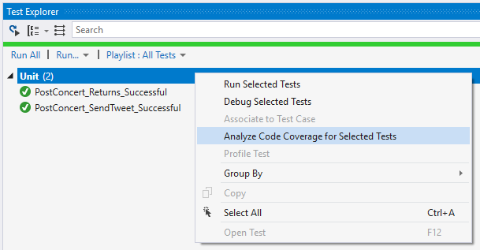
Notes:
In the Test Explorer window, you can turn this on by right-clicking the Unit heading. We only have two tests so far, so let’s see what that gives us.

Slide 29
[Route("api/concerts"), HttpPost]
public CreateUpdateConcertResponse CreateConcert([FromUri] bool tweetConcert, [FromBody] Concert concert)
{
var requestId = Guid.NewGuid().ToString("N");
RequestValidator.ValidateWebRequestHeaders(Request);
if (concert == null)
throw new ClientRequestException(HttpStatusCode.BadRequest, "Failed to parse Concert.");
if (!concert.ValidateConcert())
throw new ClientRequestException(HttpStatusCode.BadRequest, "One or more Concert prop...");
var responseModel = _concertService.CreateConcert(requestId, concert);
responseModel.TweetUrl = tweetConcert
? _tweetService.TweetConcert(concert)
: string.Empty;
return responseModel;
}
Notes:
When you analyze the code coverage, a results pane will appear that will tell you what percentage of your code is covered and not. This is where the attribute on our Test Class [Exclude From Code Coverage] is helpful. Visual Studio will ignore classes with this attribute. But you should only decorate your class with that attribute if the code SHOULD be excluded.
There is a button to Show Code Coverage Coloring.
Click over to the Concert Controller and you can see how it applies to the Post Method we are currently working on. These colors are customizable, so yours might look different.
I will include a link at the end for directions on how to do this in visual studio, so don’t worry about that part for now.
This feature does not mean the line was sufficiently tested. All it means, is that the line was executed from one of our tests. Here, green means it was, red means it wasn’t, yellow means, partially.

Slide 30
[TestMethod]
[TestCategory("Unit")]
public void PostConcert_Returns_Successful()
{
var response = _controller.CreateConcert(false, _concert);
Assert.AreEqual(1237, response.Concert.Id);
Assert.AreEqual(_requestId, response.RequestId);
}
[TestMethod]
[TestCategory("Unit")]
public void PostConcert_SendTweet_Successful()
{
var response = _controller.CreateConcert(true, _concert);
Assert.AreEqual(_tweetUrl, response.TweetUrl);
}
...
Notes:
Looking back at our tests, we only have two so far. Both of those tests validate a successful path. This leads us to our next tip for figuring out what to test.

Slide 31


Notes:
When looking at your endpoints and figuring out what to test, think of two possible outcomes. If the request is properly formed, and contains the right headers, and valid data, then the call should be successful and we should be testing that our response reflects that.
Sometimes users and clients don’t send a proper request, and we need to test that we are handling those errors appropriately.
So we have happy path and the sad path testing.

Slide 32
[Route("api/concerts"), HttpPost]
public CreateUpdateConcertResponse CreateConcert([FromUri] bool tweetConcert, [FromBody] Concert concert)
{
var requestId = Guid.NewGuid().ToString("N");
RequestValidator.ValidateWebRequestHeaders(Request);
if (concert == null)
throw new ClientRequestException(HttpStatusCode.BadRequest, "Failed to parse Concert.");
if (!concert.ValidateConcert())
throw new ClientRequestException(HttpStatusCode.BadRequest, "One or more Concert prop...");
var responseModel = _concertService.CreateConcert(requestId, concert);
responseModel.TweetUrl = tweetConcert
? _tweetService.TweetConcert(concert)
: string.Empty;
return responseModel;
}
Notes:
If our request reaches the end of our endpoint here and everything is successful, we’re testing a happy path.

Slide 33
[Route("api/concerts"), HttpPost]
public CreateUpdateConcertResponse CreateConcert([FromUri] bool tweetConcert, [FromBody] Concert concert)
{
var requestId = Guid.NewGuid().ToString("N");
RequestValidator.ValidateWebRequestHeaders(Request);
if (concert == null)
throw new ClientRequestException(HttpStatusCode.BadRequest, "Failed to parse Concert.");
if (!concert.ValidateConcert())
throw new ClientRequestException(HttpStatusCode.BadRequest, "One or more Concert prop...");
var responseModel = _concertService.CreateConcert(requestId, concert);
responseModel.TweetUrl = tweetConcert
? _tweetService.TweetConcert(concert)
: string.Empty;
return responseModel;
}
Notes:
If the request isn’t formed properly or is missing something, we are throwing exceptions here and need to test that as well.

Slide 34
[TestMethod]
[TestCategory("Unit")]
[ExpectedException(typeof(ClientRequestException))]
public void PostConcert_ConcertIsNull_ThrowsException()
{
_concert = null;
try
{
_controller.CreateConcert(false, _concert);
}
catch (ClientRequestException ex)
{
Assert.AreEqual(HttpStatusCode.BadRequest, ex.StatusCode);
Assert.AreEqual("Failed to parse Concert.", ex.Message);
_concertService.Verify(
s => s.CreateConcert(It.IsAny<string>(), It.IsAny<Concert>()), Times.Never);
throw;
}
}
Notes:
So far we’ve only have happy path tests.
In order to test a sad path, Our next test can verify that we throw an exception when the concert object is null.
Note that we are decorating our test method with Expected Exception.

Slide 35
[TestMethod]
[TestCategory("Unit")]
[ExpectedException(typeof(ClientRequestException))]
public void PostConcert_ConcertIsNull_ThrowsException()
{
_concert = null;
try
{
_controller.CreateConcert(false, _concert);
}
catch (ClientRequestException ex)
{
Assert.AreEqual(HttpStatusCode.BadRequest, ex.StatusCode);
Assert.AreEqual("Failed to parse Concert.", ex.Message);
_concertService.Verify(
s => s.CreateConcert(It.IsAny<string>(), It.IsAny<Concert>()), Times.Never);
throw;
}
}
Notes:
First, we setup concert to be null.

Slide 36
[TestMethod]
[TestCategory("Unit")]
[ExpectedException(typeof(ClientRequestException))]
public void PostConcert_ConcertIsNull_ThrowsException()
{
_concert = null;
try
{
_controller.CreateConcert(false, _concert);
}
catch (ClientRequestException ex)
{
Assert.AreEqual(HttpStatusCode.BadRequest, ex.StatusCode);
Assert.AreEqual("Failed to parse Concert.", ex.Message);
_concertService.Verify(
s => s.CreateConcert(It.IsAny<string>(), It.IsAny<Concert>()), Times.Never);
throw;
}
}
Notes:
We put a Try Catch around the controller method call, so we can catch the exception, which is what we are testing here.

Slide 37
[TestMethod]
[TestCategory("Unit")]
[ExpectedException(typeof(ClientRequestException))]
public void PostConcert_ConcertIsNull_ThrowsException()
{
_concert = null;
try
{
_controller.CreateConcert(false, _concert);
}
catch (ClientRequestException ex)
{
Assert.AreEqual(HttpStatusCode.BadRequest, ex.StatusCode);
Assert.AreEqual("Failed to parse Concert.", ex.Message);
_concertService.Verify(
s => s.CreateConcert(It.IsAny<string>(), It.IsAny<Concert>()), Times.Never);
throw;
}
}
Notes:
Verify our status code and error message.

Slide 38
[TestMethod]
[TestCategory("Unit")]
[ExpectedException(typeof(ClientRequestException))]
public void PostConcert_ConcertIsNull_ThrowsException()
{
_concert = null;
try
{
_controller.CreateConcert(false, _concert);
}
catch (ClientRequestException ex)
{
Assert.AreEqual(HttpStatusCode.BadRequest, ex.StatusCode);
Assert.AreEqual("Failed to parse Concert.", ex.Message);
_concertService.Verify(
s => s.CreateConcert(It.IsAny<string>(), It.IsAny<Concert>()), Times.Never);
throw;
}
}
Notes:
Here we are verifying that we never call Create Concert from our Concert Service. You can also verify that something is called Once, At Least Once, or a specific number of times.

Slide 39
[TestMethod]
[TestCategory("Unit")]
[ExpectedException(typeof(ClientRequestException))]
public void PostConcert_ConcertIsNull_ThrowsException()
{
_concert = null;
try
{
_controller.CreateConcert(false, _concert);
}
catch (ClientRequestException ex)
{
Assert.AreEqual(HttpStatusCode.BadRequest, ex.StatusCode);
Assert.AreEqual("Failed to parse Concert.", ex.Message);
_concertService.Verify(
s => s.CreateConcert(It.IsAny<string>(), It.IsAny<Concert>()), Times.Never);
throw;
}
}
Notes:
And here we need to remember to throw our exception.

Slide 40
[TestMethod]
[TestCategory("Unit")]
[ExpectedException(typeof(ClientRequestException))]
public void PostConcert_ConcertIsNull_ThrowsException()
{
_concert = null;
try
{
_controller.CreateConcert(false, _concert);
}
catch (ClientRequestException ex)
{
Assert.AreEqual(HttpStatusCode.BadRequest, ex.StatusCode);
Assert.AreEqual("Failed to parse Concert.", ex.Message);
_concertService.Verify(
s => s.CreateConcert(It.IsAny<string>(), It.IsAny<Concert>()), Times.Never);
throw;
}
}
_concert.Artist = null;
_concert.Artist = new Artist {Name = string.Empty};
Notes:
Then we can think about other scenarios that we might write tests for. We would also write a test where Concert isn’t null, but some of the required properties are invalid.

Slide 41
[TestMethod]
[TestCategory("Unit")]
[ExpectedException(typeof(ClientRequestException))]
public void PostConcert_ConcertIsNull_ThrowsException()
{
_concert = null;
try
{
_controller.CreateConcert(false, _concert);
}
catch (ClientRequestException ex)
{
Assert.AreEqual(HttpStatusCode.BadRequest, ex.StatusCode);
Assert.AreEqual("Failed to parse Concert.", ex.Message);
_concertService.Verify(
s => s.CreateConcert(It.IsAny<string>(), It.IsAny<Concert>()), Times.Never);
throw;
}
}
_concert.Artist = null;
_concert.Artist = new Artist {Name = string.Empty};
Notes:
Then we can think about other scenarios that we might write tests for. We would also write a test where Concert isn’t null, but some of the required properties are invalid.

Slide 42
[Route("api/concerts"), HttpPost]
public CreateUpdateConcertResponse CreateConcert([FromUri] bool tweetConcert, [FromBody] Concert concert)
{
var requestId = Guid.NewGuid().ToString("N");
RequestValidator.ValidateWebRequestHeaders(Request);
if (concert == null)
throw new ClientRequestException(HttpStatusCode.BadRequest, "Failed to parse Concert.");
if (!concert.ValidateConcert())
throw new ClientRequestException(HttpStatusCode.BadRequest, "One or more Concert prop...");
var responseModel = _concertService.CreateConcert(requestId, concert);
responseModel.TweetUrl = tweetConcert
? _tweetService.TweetConcert(concert)
: string.Empty;
return responseModel;
}
Notes:
If after writing those tests, we analyze our code again, we can see that our Exception cases have been tested.
We still have yellow lines and haven’t tested what happens when we pass FALSE for our Tweet Concert parameter

Slide 43
[TestMethod]
[TestCategory("Unit")]
public void PostConcert_DoNotSendTweet_Successful()
{
var response = _controller.CreateConcert(false, _concert);
Assert.AreEqual(string.Empty, response.TweetUrl);
}
[Route("api/concerts"), HttpPost]
public CreateUpdateConcertResponse CreateConcert([FromUri] bool tweetConcert, [FromBody] Concert concert)
{
. . .
responseModel.TweetUrl = tweetConcert
? _tweetService.TweetConcert(concert)
: string.Empty;
. . .
}
Notes:
Once we add a test that passes false in the Tweet Concert Parameter, and verify that the Tweet Url is an empty string as expected, we see that Analyze Code Coverage turns that line from Yellow, which means partially tested, to Green.

Slide 44
[Route("api/concerts"), HttpPost]
public CreateUpdateConcertResponse CreateConcert([FromUri] bool tweetConcert, [FromBody] Concert concert)
{
var requestId = Guid.NewGuid().ToString("N");
RequestValidator.ValidateWebRequestHeaders(Request);
if (concert == null)
throw new ClientRequestException(HttpStatusCode.BadRequest, "Failed to parse Concert.");
if (!concert.ValidateConcert())
throw new ClientRequestException(HttpStatusCode.BadRequest, "One or more Concert prop...");
var responseModel = _concertService.CreateConcert(requestId, concert);
responseModel.TweetUrl = tweetConcert
? _tweetService.TweetConcert(concert)
: string.Empty;
return responseModel;
}
Notes:
So now it looks like our code coverage is complete. But remember, that just means that the line of code was executed, not that the unit testing is sufficient.

Slide 45
[Route("api/concerts"), HttpPost]
public CreateUpdateConcertResponse CreateConcert([FromUri] bool tweetConcert, [FromBody] Concert concert)
{
var requestId = Guid.NewGuid().ToString("N");
RequestValidator.ValidateWebRequestHeaders(Request);
if (concert == null)
throw new ClientRequestException(HttpStatusCode.BadRequest, "Failed to parse Concert.");
if (!concert.ValidateConcert())
throw new ClientRequestException(HttpStatusCode.BadRequest, "One or more Concert prop...");
var responseModel = _concertService.CreateConcert(requestId, concert);
responseModel.TweetUrl = tweetConcert
? _tweetService.TweetConcert(concert)
: string.Empty;
return responseModel;
}
Notes:
In fact, we didn’t really test a Sad Path outcome for Validating the Web Request Headers. This is a static class method that checks to make sure a app ID header and a user ID header are included in the request. Let’s take a look at that static class now.

Slide 46
public static class RequestValidator
{
public static void ValidateWebRequestHeaders(HttpRequestMessage request)
{
var appIdHeader = ConfigurationValues.AppIdHeader;
var userIdHeader = ConfigurationValues.UserIdHeader;
if (!request.Headers.Contains(appIdHeader) ||
request.Headers.GetValues(appIdHeader).All(string.IsNullOrWhiteSpace))
{
throw new ClientRequestException(HttpStatusCode.BadRequest, "Missing AppId header.");
}
if (!request.Headers.Contains(userIdHeader) ||
request.Headers.GetValues(userIdHeader).All(string.IsNullOrWhiteSpace))
{
throw new ClientRequestException(HttpStatusCode.BadRequest, "Missing UserId header.");
}
}
}
Notes:
We can see that we aren’t testing the Sad Path that throws exceptions when the headers are missing.
We already know how to solve for this.

Slide 47
[TestMethod]
[TestCategory("Unit")]
[ExpectedException(typeof(ClientRequestException))]
public void PostConcert_AppIdHeaderMissing_ThrowsException()
{
_request.Headers.Remove("app_id");
try
{
_controller.CreateConcert(false, _concert);
}
catch (ClientRequestException ex)
{
Assert.AreEqual(HttpStatusCode.BadRequest, ex.StatusCode);
Assert.AreEqual("Missing AppId header.", ex.Message);
_concertService.Verify(
s => s.CreateConcert(It.IsAny<string>(), It.IsAny<Concert>()), Times.Never);
throw;
}
}
Notes:
This should look familiar. It’s very similar to our other tests for throwing exceptions.

Slide 48
[TestMethod]
[TestCategory("Unit")]
[ExpectedException(typeof(ClientRequestException))]
public void PostConcert_AppIdHeaderMissing_ThrowsException()
{
_request.Headers.Remove("app_id");
try
{
_controller.CreateConcert(false, _concert);
}
catch (ClientRequestException ex)
{
Assert.AreEqual(HttpStatusCode.BadRequest, ex.StatusCode);
Assert.AreEqual("Missing AppId header.", ex.Message);
_concertService.Verify(
s => s.CreateConcert(It.IsAny<string>(), It.IsAny<Concert>()), Times.Never);
throw;
}
}
Notes:
This time in the setup, we are removing the header in order to test this scenario.

Slide 49
[TestMethod]
[TestCategory("Unit")]
[ExpectedException(typeof(ClientRequestException))]
public void PostConcert_AppIdHeaderMissing_ThrowsException()
{
_request.Headers.Remove("app_id");
try
{
_controller.CreateConcert(false, _concert);
}
catch (ClientRequestException ex)
{
Assert.AreEqual(HttpStatusCode.BadRequest, ex.StatusCode);
Assert.AreEqual("Missing AppId header.", ex.Message);
_concertService.Verify(
s => s.CreateConcert(It.IsAny<string>(), It.IsAny<Concert>()), Times.Never);
throw;
}
}
_request.Headers.Remove("user");
Notes:
We would then write an almost identical test for the user header.

Slide 50
public static class RequestValidator
{
public static void ValidateWebRequestHeaders(HttpRequestMessage request)
{
var appIdHeader = ConfigurationValues.AppIdHeader;
var userIdHeader = ConfigurationValues.UserIdHeader;
if (!request.Headers.Contains(appIdHeader) ||
request.Headers.GetValues(appIdHeader).All(string.IsNullOrWhiteSpace))
{
throw new ClientRequestException(HttpStatusCode.BadRequest, "Missing AppId header.");
}
if (!request.Headers.Contains(userIdHeader) ||
request.Headers.GetValues(userIdHeader).All(string.IsNullOrWhiteSpace))
{
throw new ClientRequestException(HttpStatusCode.BadRequest, "Missing UserId header.");
}
}
}
Notes:
After writing those tests, we can see that our code coverage shows we are testing this method thoroughly.

Slide 51
Problem 2:
I don’t know what to test
Notes:
We are rocking our unit tests. We solved problem 2 by turning on code coverage and making sure each line was executed by our Unit Tests. We know that this does not ensure that we have written proper tests, but it is one useful tool in our toolset to help us see what we haven’t tested. We also saw that we need to dig deeper into the methods outside our class to make sure they get fully tested, like the method that validated our headers. We looked at testing not only Happy Paths, but Sad Paths to ensure we handle bad requests properly.

Slide 52


Integration Testing with Postman
Environment Variables
Collections
Tests
Global Variables
Automation
Notes:
Now we will focus on integration testing for this second part.
You can write your integration tests inside of visual studio, but that requires a certain amount of boilerplate code. I like that postman handles that for us, and makes writing tests easy.
John Butler

Slide 53
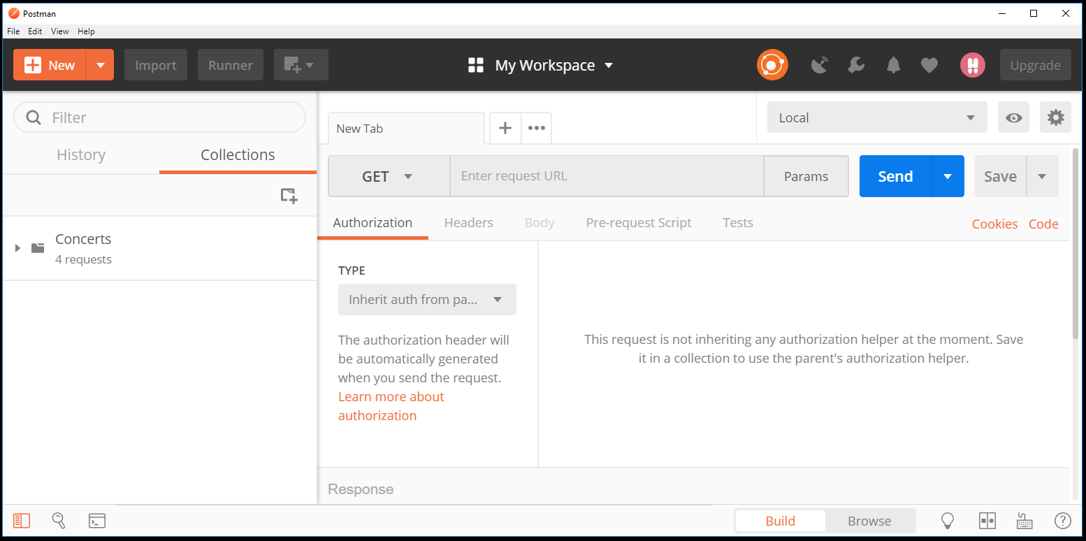
Notes:
If you haven’t used it before, here’s what postman looks like. On the left you have Collections and History, and on the right you have details for making your API calls, the result of those calls once they’ve been sent, and tests. We’ll break it down as we go along.

Slide 54
Notes:
The first thing I like to do in Postman is set up some environment variables.

Slide 55
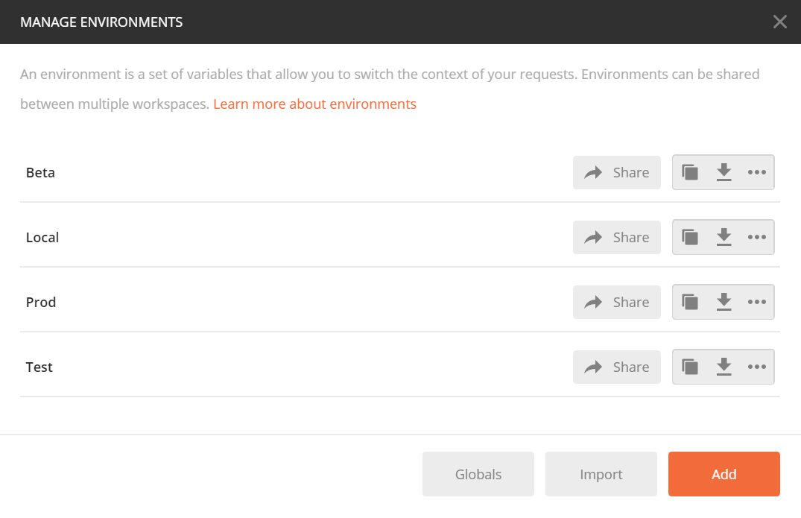
Notes:
Here I have 4 different environments set up. Each of these environments would require a different URL for the endpoints of my API and possibly different header values.

Slide 56
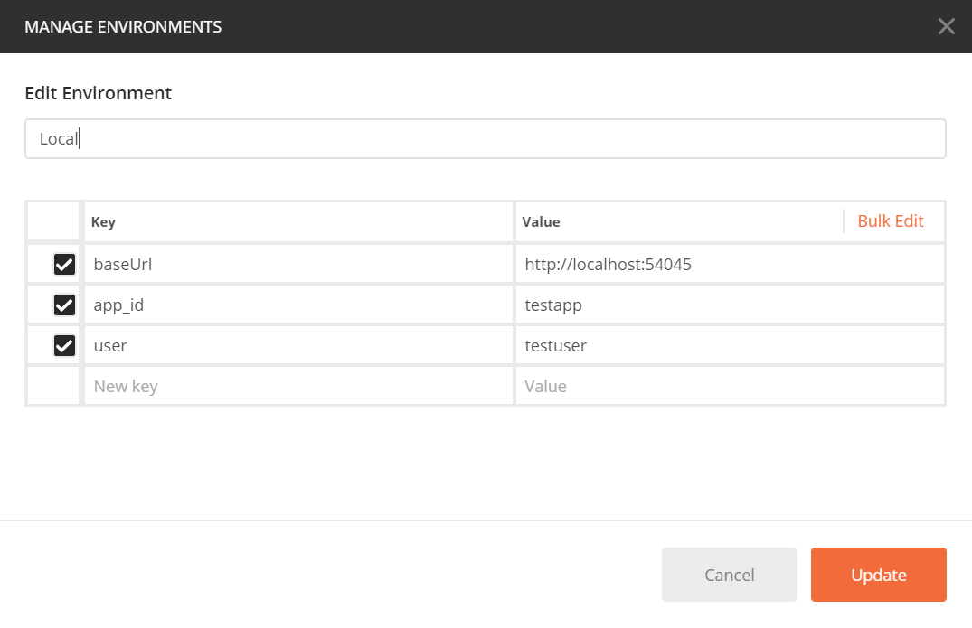
Notes:
For instance, in my Local environment, my URL is going to be localhost. I have some header variables with different values than I would use in Beta or Production.

Slide 57
Notes:
After setting up environment variables, I like to start a collection for the project or application I’m testing. Collections help you organize your API calls into logical groups. It also allows us to run our tests over a complete collection, which we’ll look at later.

Slide 58
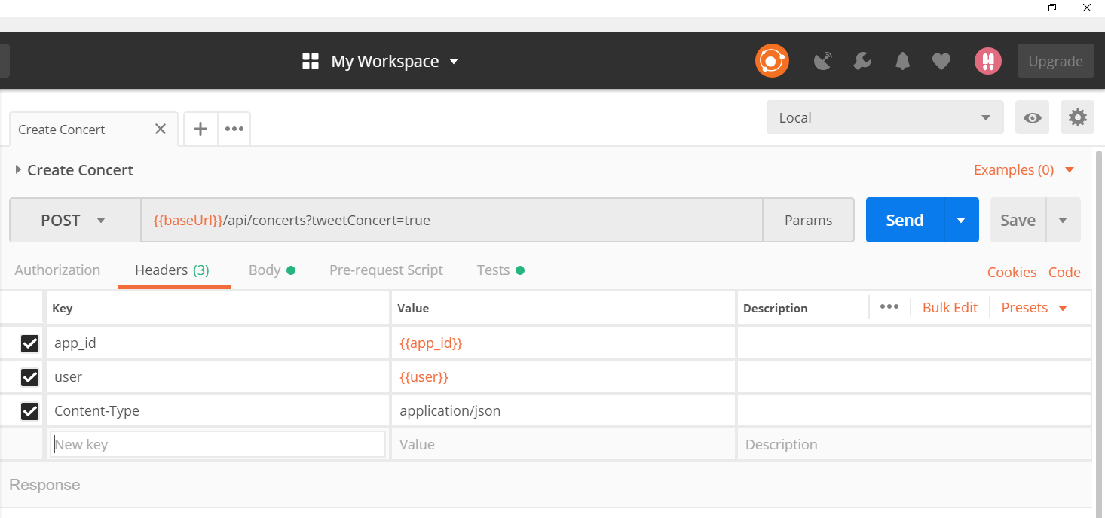
Notes:
Here is where you choose the verb for your call: Get, put, post, delete, etc.

Slide 59
Notes:
Here is where the URL goes.

Slide 60
Notes:
Below that, we have a Headers tab where we can configure our request headers.

Slide 61
Notes:
And you can see in both the URL and headers we are using the environment variables that we set up.

Slide 62
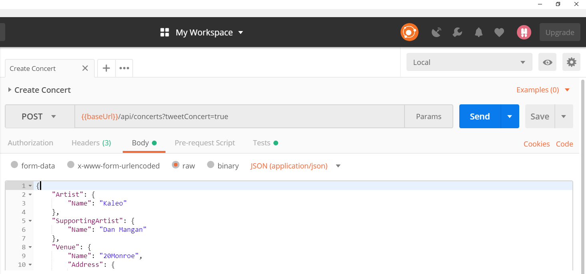
Notes:
Next, we can look at the Body tab. For creating a new concert, we need to send a json object of the new concert. This is where that json is entered.
And that’s all you need to send a call. From here we can click send and see the result, or we can save it to our collection. But we are more interested in writing some tests for our API. Let’s take a look at that.

Slide 63
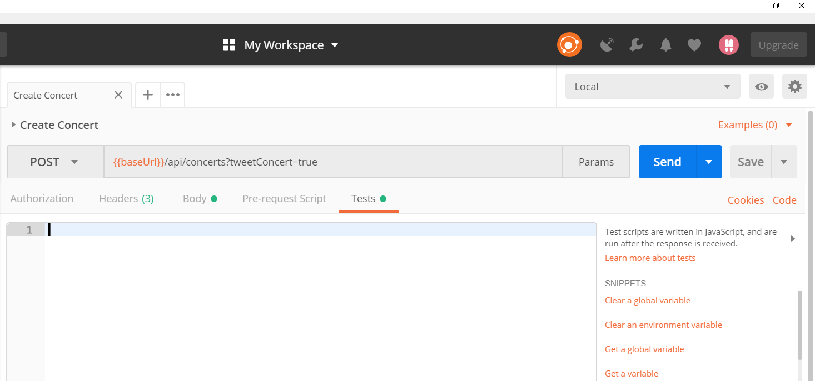
Notes:
Under the tests tab, we can write our integration tests. Postman tests are written in javascript, so knowing javascript is very helpful.

Slide 64
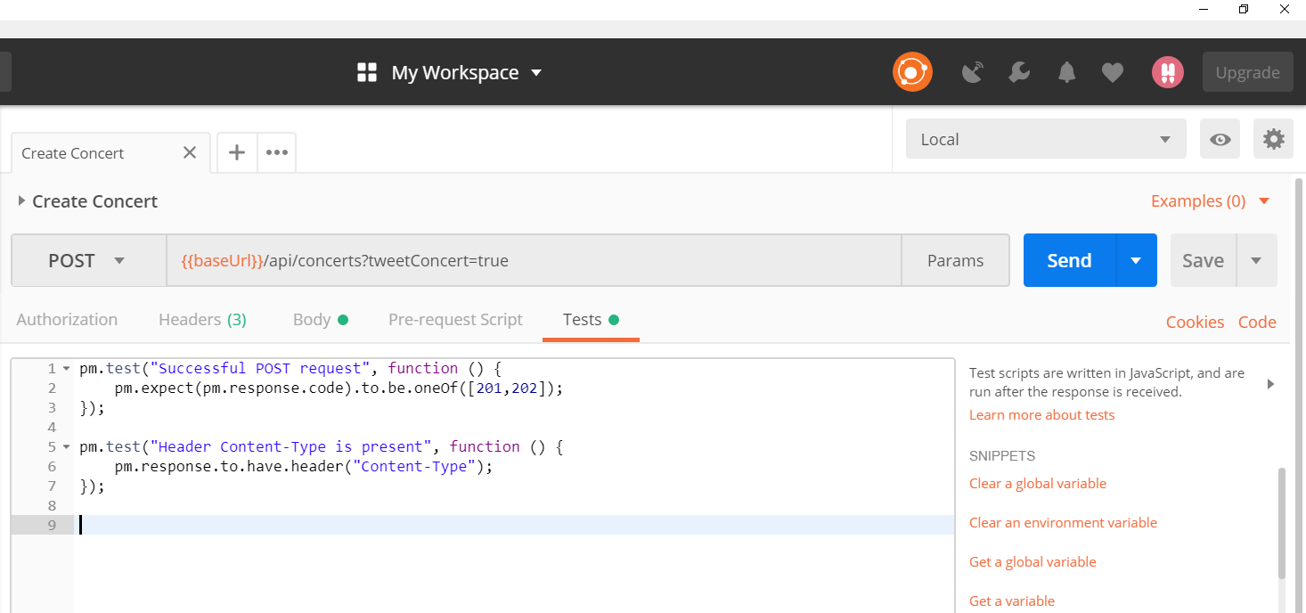
Notes:
But one nice feature of postman is they include several test snippets. Let’s take a closer look at these tests.

Slide 65
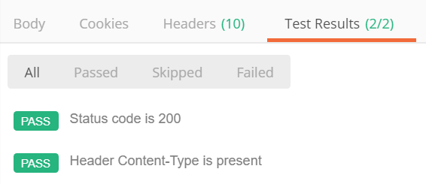
pm.test("Status code is 200", function () {
pm.response.to.have.status(200);
});
pm.test("Header Content-Type is present", function () {
pm.response.to.have.header("Content-Type");
});
Notes:
PM here is the postman API for testing. And the pm.test() function is used to write tests inside the postman test sandbox. The function accepts two parameters – the name of the test as a string, and a function to return a bolean value.
When you run the tests, the results show below the tests panel.

Slide 66
Notes:
If we want to write a test to ensure that our response object matches our schema. There is a snippet for that as well.
First, we need to define our schema somewhere. Instead of putting it directly in our test, we can save it to a global variable so we can access it from all our tests.

Slide 67
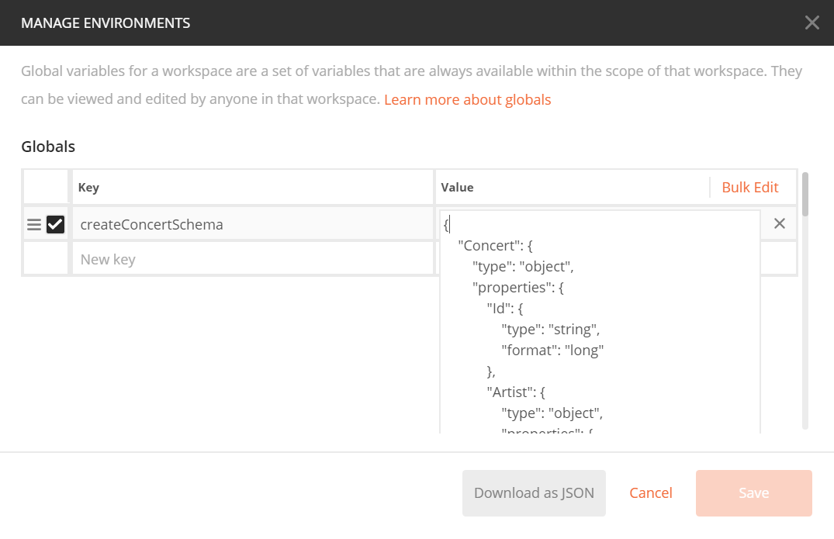
Notes:
Just like our environment variables that we set up, we give the key a name and value. In this case the value is our json schema.

Slide 68
pm.test("Status code is 200", function () {
pm.response.to.have.status(200);
});
pm.test("Header Content-Type is present", function () {
pm.response.to.have.header("Content-Type");
});
var schema = pm.globals.get("createConcertSchema");
var responseBody = pm.response.json();
pm.test("Schema is valid", function() {
pm.expect(tv4.validate(responseBody, schema, false, true)).to.be.true;
});
Notes:
In our test, we retrieve the value of our global variable first.
The test portion was generated from the snippet. You can see that it uses something called tiny validator (where it has tv4). Tiny Validator is used to validate both simple values and complex objects for json schema. I have a link at the end for more information on Tiny Validator.

Slide 69
var schema = pm.globals.get("createConcertSchema");
var responseBody = pm.response.json();
pm.test("Schema is valid", function() {
pm.expect(tv4.validate(responseBody, schema, false, true)).to.be.true;
});
var requestId = responseBody.RequestId;
var requestIdLength = requestId.length;
pm.test("Request Id is valid", function() {
pm.expect(requestIdLength > 0).to.be.true;
})
Notes:
Another test we might want to include is to validate our request ID.
This group of code tests that the request ID is valid by checking the length of the value.

Slide 70
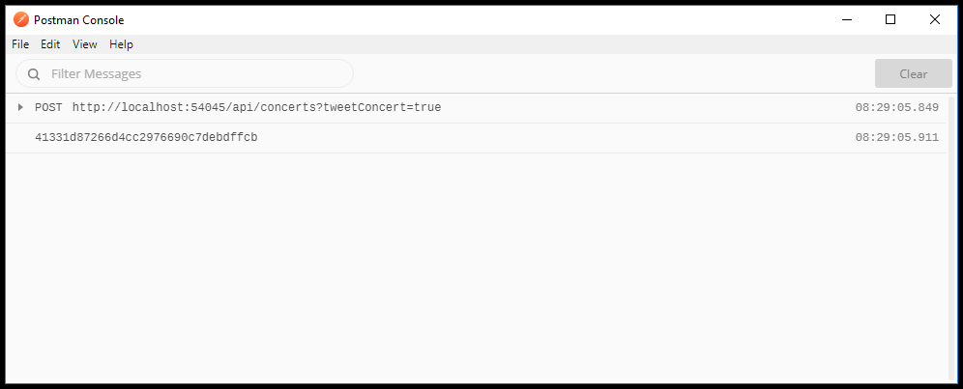
Notes:
As you write tests, you may want to log to the console. This can help with debugging your tests. For instance, if I want to see what the value of my request ID looks like, I might log the request ID to the console.

Slide 71
Notes:
To bring up the console, you click on this button at the button.

Slide 72
Notes:
So now we have tests for each of our endpoints and the corresponding tests run when we send the request.
But if we just want to run all our tests without clicking send on each request, we can run the entire collection with it’s tests by clicking the Runner button at the top.

Slide 73
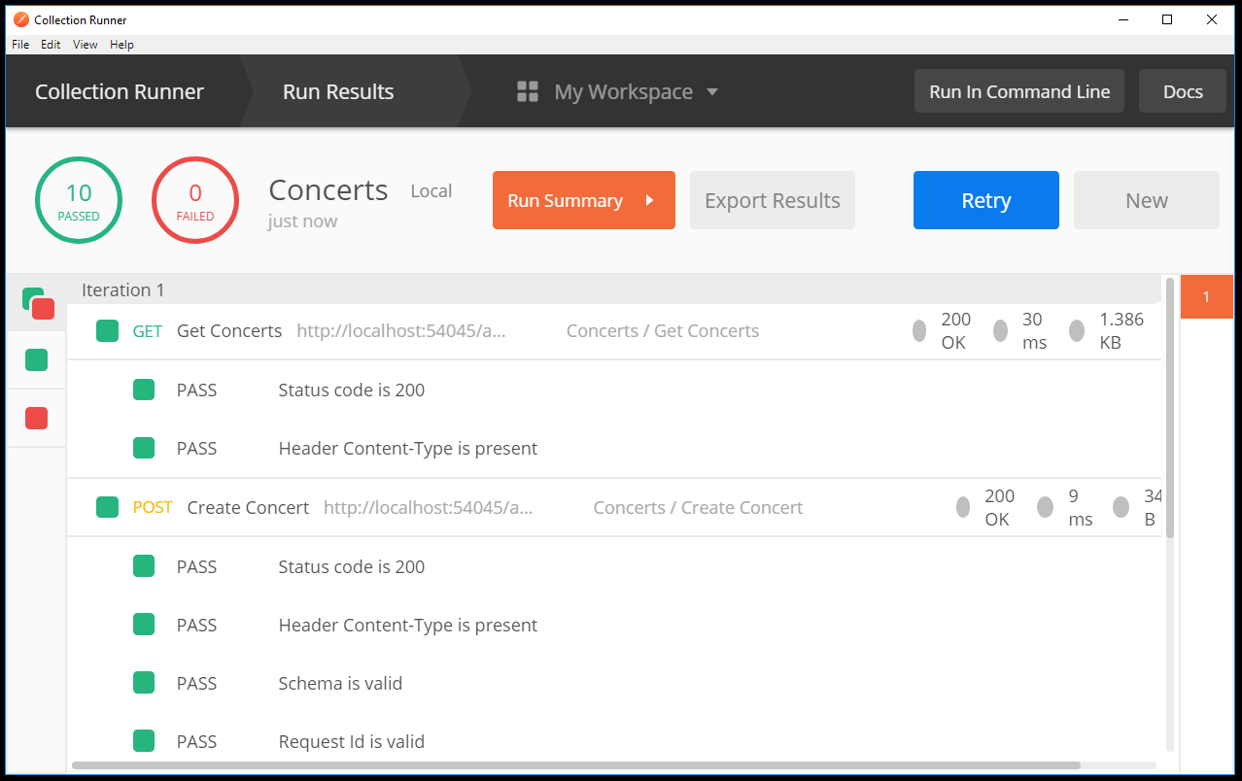

Notes:
This will run your collection and display the results for each API call. This is nice – running all your tests at the click of a button! But what you probably really want to do is automate this within your continuous integration process.
You can automate your tests by integrating Postman’s command line tool, Newman, with your CI/CD tool. I’m using Travis CI for this project. But it also integrates easily with github, Jenkins, etc.
The first step to automate our tests is to download all the required pieces: The collections, the environment variables, and the global variables.

Slide 74
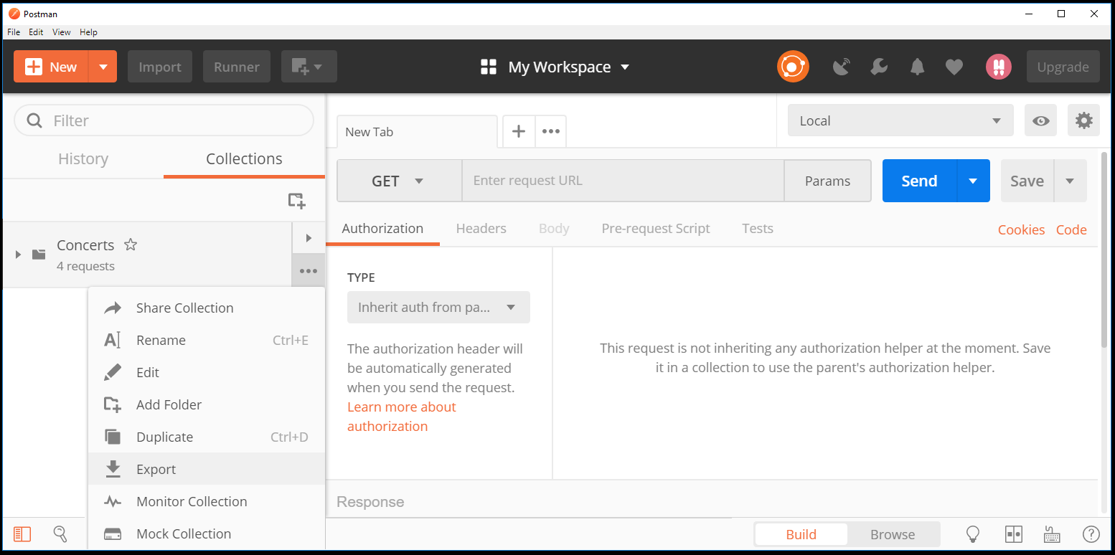
Notes:
Export your collection. The tests for the collection are included.

Slide 75
Notes:
Download the environment that you want to test against.

Slide 76
Notes:
Download your global variables

Slide 77
.travis.yml
language: csharp
solution: ConcertDiary.sln
install:
- npm install newman
script:
- node_modules/.bin/newman run tests/Concerts.postman_collection.json
-e tests/Local.postman_environment.json
-g tests/My_Workspace.postman_globals.json
Notes:
For this project, I’m using Travis CI as my build tool. I created a yamel file called .travis.yml and saved it to the root directory of my visual studio project solution.

Slide 78
→ Get Concerts
GET https://tonyazen/api/concerts
✓ Status code is 200
✓ Header Content-Type is present
→ Create Concert
POST https://tonyazen/api/concerts?tweetConcert=true
✓ Status code is 200
✓ Header Content-Type is present
✓ Schema is valid
✓ Request Id is valid
→ Update Concert
PUT https://tonyazen/api/concerts/2?tweetConcert=false
✓ Status code is 200
✓ Header Content-Type is present
→ Delete Concert
DELETE https://tonyazen/api/concerts/3
✓ Status code is 200
✓ Header Content-Type is present
┌─────────────────────────┬──────────┬──────────┐
│ │ executed │ failed │
├─────────────────────────┼──────────┼──────────┤
│ iterations │ 1 │ 0 │
├─────────────────────────┼──────────┼──────────┤
│ requests │ 4 │ 0 │
├─────────────────────────┼──────────┼──────────┤
│ test-scripts │ 4 │ 0 │
├─────────────────────────┼──────────┼──────────┤
│ prerequest-scripts │ 1 │ 0 │
├─────────────────────────┼──────────┼──────────┤
│ assertions │ 10 │ 0 │
├─────────────────────────┴──────────┴──────────┤
Notes:
When I commit to my git hub repo, the project builds on Travis CI and my tests are automatically ran. This is the report that is displayed when everything passes. If there were failures, they would show up in red and there would be an explanation of the failure below this report.

Slide 79
Questions
Notes:
Question?

Slide 80
References
Testing Pyramid: https://martinfowler.com/articles/practical-test-pyramid.html
Unity: http://www.tutorialsteacher.com/ioc/register-and-resolve-in-unity-container
Code Coverage: https://msdn.microsoft.com/en-us/library/dd537628.aspx
Postman: http://blog.getpostman.com/2017/07/28/api-testing-tips-from-a-postman-professional/
Tiny Validator: https://geraintluff.github.io/tv4/
Slides: https://speakerdeck.com/tonyazen/testing-the-endpoints-of-your-rest-apis

Slide 81
Thank you
@tonyazen

